Slide 1
24 Single-Source Shortest Paths Problem
Problem Description and Related Notions
Properties of Shortest-Paths and Relaxation
The Bellman-Ford Algorithm
Single-Source Shortest Paths in Directed Acyclic Graphs
Dijkstra’s algorithm

Slide 2
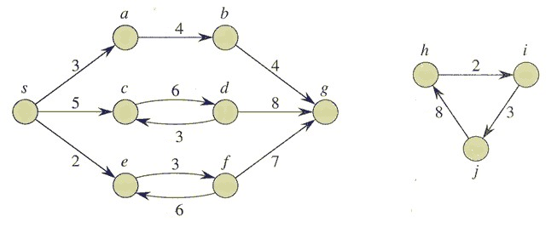
Single-Source Shortest Paths Problem
Input: A weighted directed graph G=(V, E, w), and a source vertex s.
Output: Shortest-path weight from s to each vertex v in V, and a shortest path from s to vertex v if v is reachable from s.

Slide 3
Shortest Paths—Notions
Given a weighted, directed graph G = (V, E; w), the weight of path p = <v₀, v₁, …, v_{k}> is the sum of the weights of its constituent edges, that is,
The shortest-path weight from u to v is defined as

Slide 4
Shortest paths – an example

Slide 5
Optimal substructure of Shortest Paths
Lemma 24.1 (Subpaths of shortest paths are shortest paths)
Can you give a proof?

Slide 6
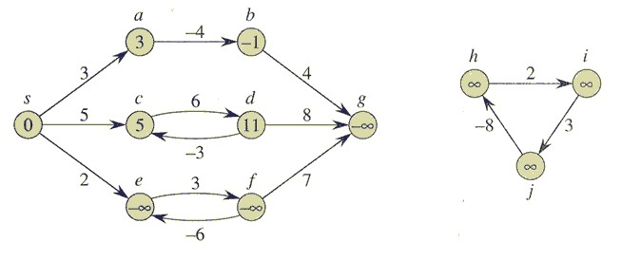
Negative-weight Edge & Negative-weight Cycle
If there is a negative-weight cycle on some path from s to v,
we define δ(u, v) = -∞.

Slide 7
Cycles
Three typies of cycle: negative-weight cycle,
positive-weight cycle,
0-weight cycle
We can assume that when we are finding shortest paths, they are cycle-free.
Consequently, we can restrict our attention to shortest paths of at most |V|-1 edges.

Slide 8
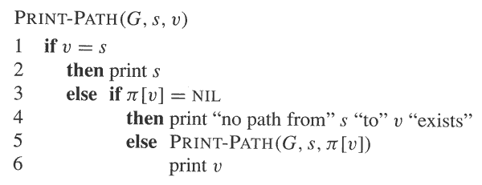
Representing Shortest-Paths
Given a graph G = (V, E), for each vertex v ∈V , maintain a predecessor π[v].
Given a vertex v for which π[v] ≠ NIL, the procedure PRINT-PATH(G, s, v) prints a shortest path from s to v.

Slide 9
Predecessor subgraph
Predecessor subgraph G_{π} = (V_{π}, E_{π}):
V_{π} = {v ∈V: π[v] ≠ NIL} ∪{s}
E_{π} = {(π[v] , v) ∈E: v ∈V_{π} -{s}}
We will prove later that π values produced by the algorithms in this chapter have the property that at termination G_{π} is a “shortest-paths tree”

Slide 10
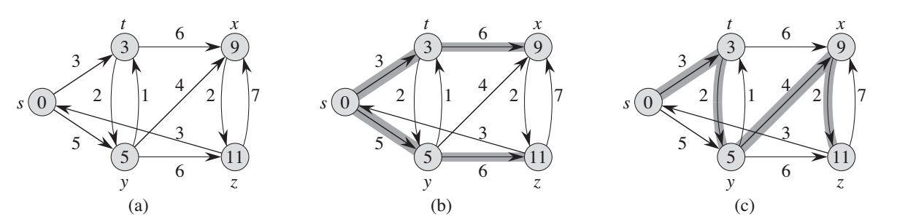
Shortest-Paths Tree
Let G = (V, E;w) be a weighted, directed graph, and assume that G contains no negative cycles that are reachable from s. A shortest-paths tree rooted at s is a directed subgraph G’=(V’, E’), where V’⊆V and E’⊆E, such that
V’ is the set of vertices reachable from s in G,
G’ forms a rooted tree with root s, and
For all v ∈V’, the unique simple path from s to v in G’ is a shortest path from s to v in G.
The shortest-path tree may not be unique.

Slide 11
The technique of Relaxation
In our shortest-paths problem, we maintain an array d[], where d[v] is an estimate of δ(s, v).
The term relaxation is used here for an operation that tightens d[v], or reduces the difference of d[v] and δ(s, v).
Shortest-path estimate

Slide 12
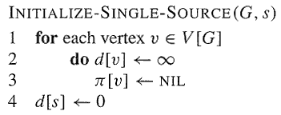
Relaxation －Initialization
The initial estimate of δ(s, v) can be given by:

Slide 13
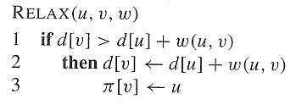
Relaxation Process
Relaxing an edge (u, v) consists of:
Testing whether we can improve the shortest path from s to v found so far by going through u to v, and if so,
Updating d[v] and π[v].

Slide 14
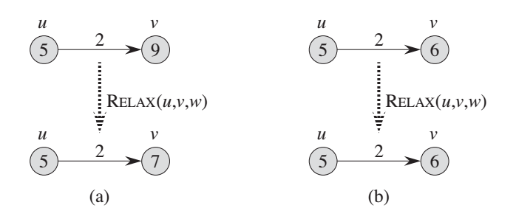
Results of Relaxation
A relaxation step may either decrease the value of d[v] and update π[v], or cause no change.

Slide 15
Some notes about Relaxation
Note:
All algorithms in this chapter calls INITIALIZE-SINGLE-SOURCE and then repeatedly relax edges;
Relaxation is the only means by which shortest-path estimates and predecessors change;
The algorithms differ in how many times they relax each edge and the order in which they relax edges;
Bellman-Ford’s algorithm: relaxes each edge many times,
Dijkstra’s algorithm: exactly once
Algorithm for directed acyclic graphs: exactly once

Slide 16
Properties of Shortest Paths and Relaxation
Suppose we have already initialized d[] and π[], and the only way used to change their values is relaxation.
Triangle inequality (Lemma 24.10)
For any edge (u, v) ∈E, we have δ(s, v) ≤ δ(s, u) + w(u, v)
Upper-bound property (Lemma 24.11)
We always have d[v] ≥ δ(s, v) for all vertices v ∈V, and once d[v] achieves the value δ(s, v), it never changes.
No-path property (Lemma 24.12)
If there is no path from s to v, then we always have d[v] = δ(s, v) = ∞.

Slide 17
Properties of Shortest Paths and Relaxation
Convergence property (Lemma 24.14)
If s → u→ v is a shortest path from s to v in G, and if d[u] = δ(s,u) at any time prior to relaxing edge (u,v), then d[v] = δ(s,v) at all times after relaxing edge (u,v).
Path-relaxation property (Lemma 24.15)
If p = <s, v₁, …, v_{k}> is a shortest path from s to v_{k}, and the edges of p are relaxed in the order (s, v₁), (v₁, v₂), …, (v_{k-1}, v_{k}), then after relaxing all the edges, d[v_{k}] = δ(s, v_{k}).
Note that other relaxations may take place among these relaxations.

Slide 18
Properties of Shortest Paths and Relaxation
Predecessor-subgraph property (Lemma 24.17)
Once d[v] = δ(s, v) for all v ∈V, the predecessor subgraph is a shortest-paths tree rooted at s.
Note: Proofs for all these properties can be found in textbook (section 24.5).

Slide 19
Single-source shortest path problem
Input: A weighted directed graph G=(V, E; w) and a source vertex s.
Output: Shortest-path weight from s to each vertex v in V, and a shortest path from s to vertex v if v is reachable from s.

Slide 20
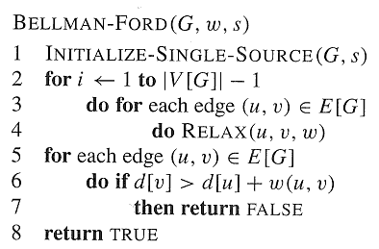
The Bellman-Ford Algorithm

Slide 21
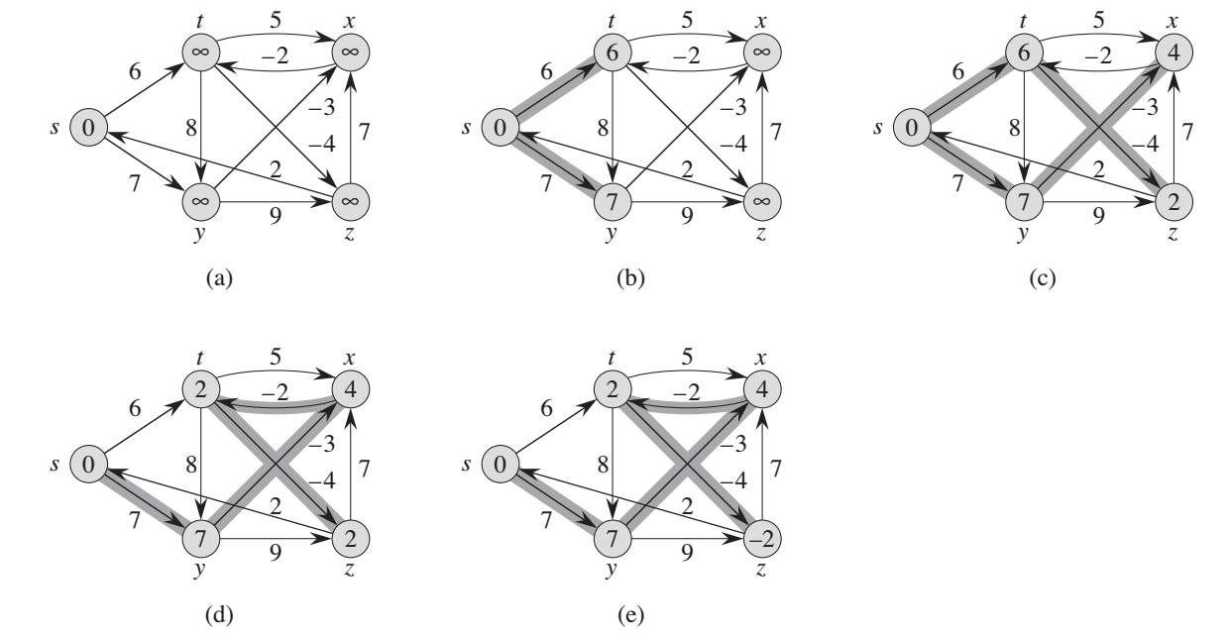
Note: each pass relaxes the edges in the order:
(t,x), (t,y), (t,z), (x,t), (y,x), (y,z), (z,x), (z,s), (s,t), (s,y)

Slide 22
Time Complexity of The Bellman-Ford
The time complexity is O(VE)

Slide 23
Correctness of The Bellman-Ford
Lemma 24.2 Let G = (V, E) be a weighted, directed graph with source s and weight function w: E→R, and assume that G contains no negative cycles that are reachable from s. Then, after the | V | - 1 iterations of the for loop of lines 2-4 of BELLMAN-FORD, we have d[v] = δ(s, v) for all vertices v reachable from s.
Proof: Consider any vertex v that is reachable from s. Since G contains no negative-weight cycles that are reachable from s, there must be at least one acyclic shortest path from s to v. Let p = <v₀, v₁, …, v_{k}>, where v₀ = s and v_{k} = v, be such a path from s to v. Path p has at most |V|-1 edges, and so k ≤ |V|-1. Since each of the |V|-1 iterations of the for loop of lines 2-4 relaxes all |E| edges, the edge (v_{i-1}, v_{i}) in P is relaxed in the ith iteration, for i = 1, 2, …, k. By the path-relaxation property, d[v] = d[v_{k}] = δ(s, v_{k}) = δ(s, v).

Slide 24
Correctness of The Bellman-Ford
Corollary 24.3
Let G = (V, E) be a weighted, directed graph with source s and weight function w: E→R. Then for each vertex v ∈V, there is a path from s to v if and only if BELLMAN-FORD terminates with d[v] < ∞ when it is run on G.

Slide 25
Correctness of The Bellman-Ford
Theorem 24.4
Let BELLMAN-FORD be run on a weighted, directed graph G = (V, E) with source s and weight function w: E→R. If G contains no negative cycles that are reachable from s, then the algorithm returns TRUE, we have d[v] = δ(s, v) for all vertices v ∈V, and the predecessor subgraph G_{π} is a shortest-paths tree rooted at s. If G does contain a negative weight cycle reachable from s, then the algorithm returns FALSE.

Slide 26
Correctness of The Bellman-Ford
Restatement of Theorem 24.4:

Slide 27
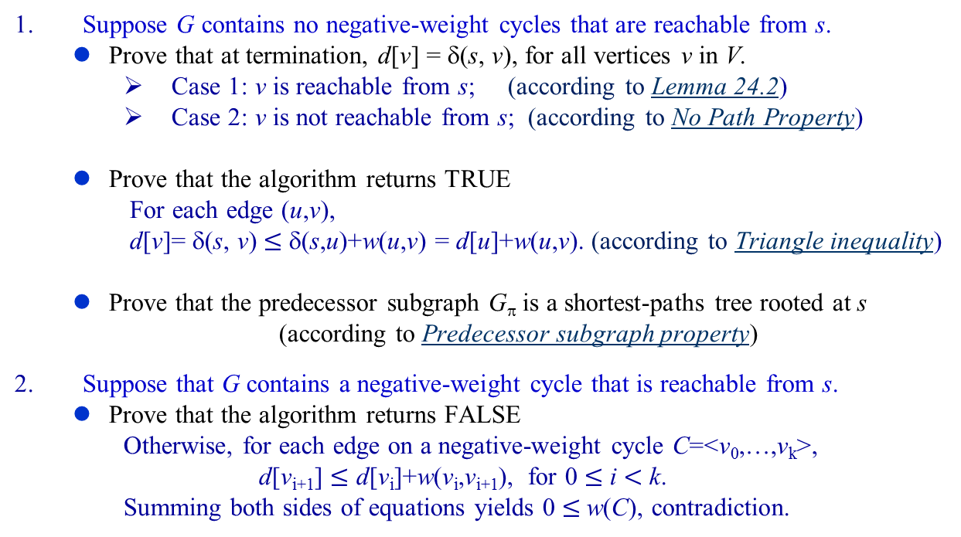
Proof of Theorem 24.4
Suppose G contains no negative-weight cycles that are reachable from s.
Prove that at termination, d[v] = δ(s, v), for all vertices v in V.
Case 1: v is reachable from s; (according to Lemma 24.2)
Case 2: v is not reachable from s; (according to No Path Property)
Prove that the algorithm returns TRUE
For each edge (u,v),
d[v]= δ(s, v) $≤$ δ(s,u)+w(u,v) = d[u]+w(u,v). (according to Triangle inequality)
Prove that the predecessor subgraph G_{π} is a shortest-paths tree rooted at s
(according to Predecessor subgraph property)
Suppose that G contains a negative-weight cycle that is reachable from s.
Prove that the algorithm returns FALSE
Otherwise, for each edge on a negative-weight cycle C=<v₀,…,v_{k}>,
d[v_{i+1}] $≤$ d[v_{i}]+w(v_{i},v_{i+1}), for 0 $≤$ i $<$ k.
Summing both sides of equations yields 0 $≤$w(C), contradiction.

Slide 28
Single-Source Shortest Paths in Directed Acyclic Graphs
Preparation:
Can you give a topological sort of the following graph?

Slide 29
Single-Source Shortest Paths in Directed Acyclic Graphs
Can you find shortest-paths from s to all other vertices using Bellman-Ford algorithm?
Note: each pass relaxes the edges in the order:
(r,s), (r,t), (s,x), (s,t), (t,x), (t,y), (t,z), (x,y), (x,z), (y,z)

Slide 30
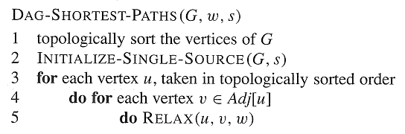
Single-Source Shortest Paths in Directed Acyclic Graphs

Slide 31
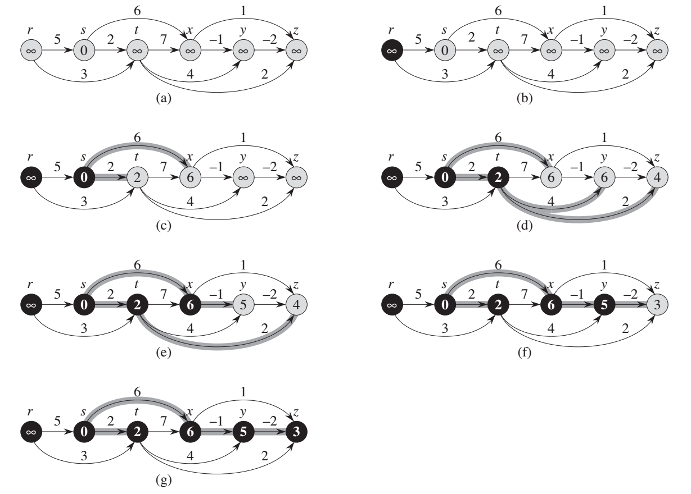

Slide 32
Time Complexity
Time Complexity: Θ(V+E)

Slide 33
Correctness of the Algorithm
Theorem 24.5 If a weighted, directed graph G = (V, E) has source vertex s and no cycles, then at the termination of the DAG-SHORTEST-PATHS procedure, d[v] = δ(s, v) for all vertices v ∈V, and the predecessor subgraph G_{π} is a shortest-paths tree rooted at s.
Proof
1. case 1: v is not reachable from s. By no path property, d[v] = δ(s, v) = ∞
case 2: v is reachable from s, then there is a shortest path p from s to v, p = <v₀, v₁, …, v_{k}>, where v₀ = s and v_{k} = v. (path relaxation property)
2. (Predecessor subgraph property).

Slide 34
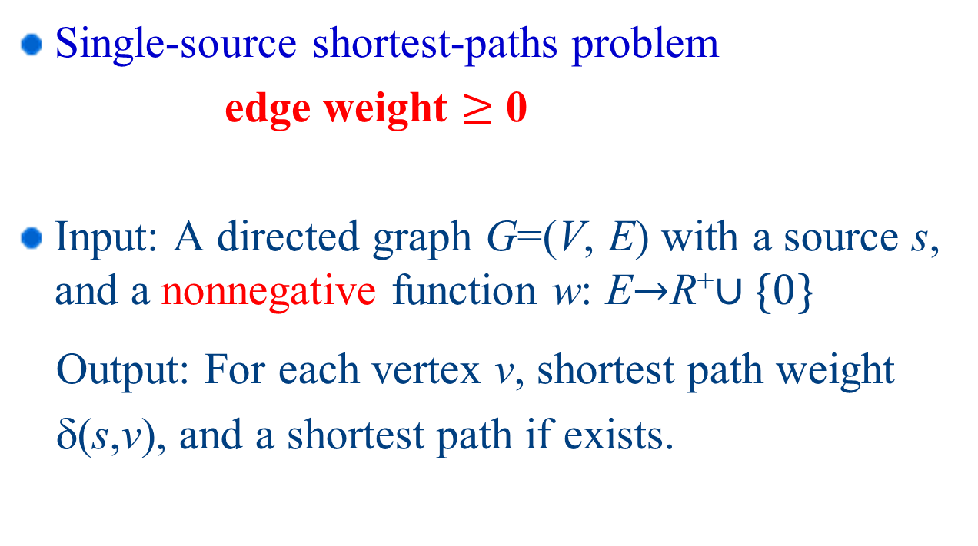
Dijkstra’s Algorithm
Single-source shortest-paths problem
edge weight $≥$ 0
Input: A directed graph G=(V, E) with a source s, and a nonnegative function w: ER⁺$∪\{0\}$
Output: For each vertex v, shortest path weight
δ(s,v), and a shortest path if exists.

Slide 35
Dijkstra’s Algorithm
Basic Idea

Slide 36
Dijkstra’s Algorithm
DIJKSTRA(G,w,s)
INITIALIZE-SINGLE-SOURCE(G,s)
S←∅
Q←V[G]
while Q≠∅
5. do u←EXTRACT-MIN(Q)
6. S←S∪{u}
7. for each v ∈Adj[u]
8. do RELAX(u,v,w)

Slide 37
Dijkstra’s Algorithm - example
Initial Graph

Slide 38
Dijkstra’s Algorithm - Operation
Initialize graph
S= ∅
Q={s, x, y, u, v}
S={s}
Q={x, y, u, v}
Red arrows show
predecessors

Slide 39
Dijkstra’s Algorithm - Operation
S={s, x}
Q={y, u, v}
S={s, x, y}
Q={u, v}

Slide 40
Dijkstra’s Algorithm - Operation
S={s, x, y, u}
Q={v}
S={s, x, y, u , v}
Q= ∅

Slide 41
Correctness of Dijkstra’s
Theorem 24.6
Dijkstra’s algorithm, run on a weighted,directed graph G=(V, E), with non-negative weight function w and source s, terminates with d[u]= δ(s,u) for all vertices u∈V.
Proof (by contradiction)
Since S=V in the end, we only need to prove that for each vertex u added to S, there holds d[u]= δ(s, u) when u is added to S.
Suppose that u is the first vertex for which d[u] ≠ δ(s, u) when it was added to S
Note
u is not s because d[s] = 0= δ(s, s)
There must be a path s→...→u, since otherwise d[u]= δ(s, u) = ∞.
Since there’s at least one path from s to u, there must be a shortest path from s to u. (Note there is no negative cycle).

Slide 42
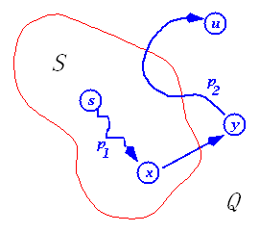
Dijkstra’s Algorithm - Proof
Let s x→y u be a shortest path from s to u, where at the moment u is chosen to S,
x is in S and y is the first outside S
When x was added to S, d[x] = δ(s, x)
Edge x→y was relaxed at that time, so,
by convergence property, at time u is
chosen, d[y] = δ(s, y)

Slide 43
Dijkstra’s Algorithm - Proof
So, at time u is chosen to S,
d[y]= δ(s, y) ≤ δ(s, u) ≤ d[u]
But, when we chose u, both u and y are in Q, so d[u] ≤ d[y] (otherwise we would have chosen y)
Thus the inequalities must be equalities
and d[y] = δ(s, y) = δ(s, u) = d[u]
And our hypothesis (d[u] ≠ δ(s, u)) is contradicted!
1.Why the red inequality holds?
2. How about if negative edges exist?

